Slide 1

A 4-Way Traffic Light using RGB LED
By Michael Caruana

Slide 2
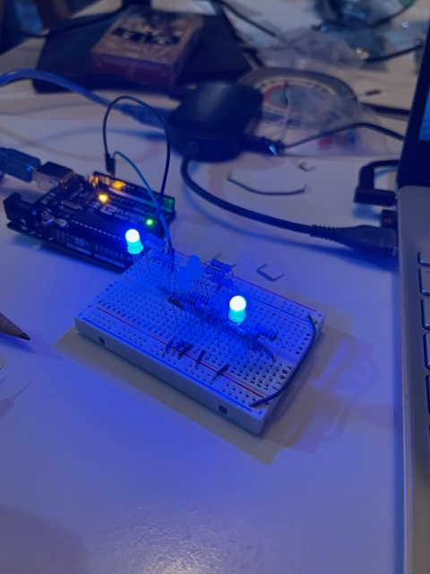
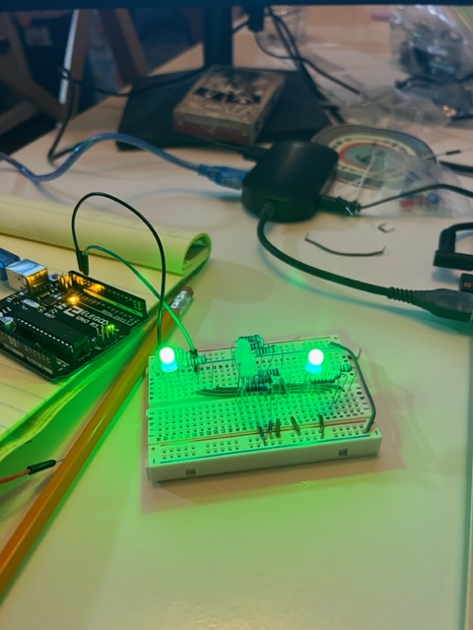
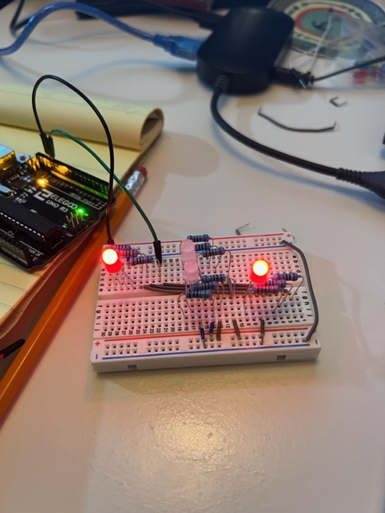
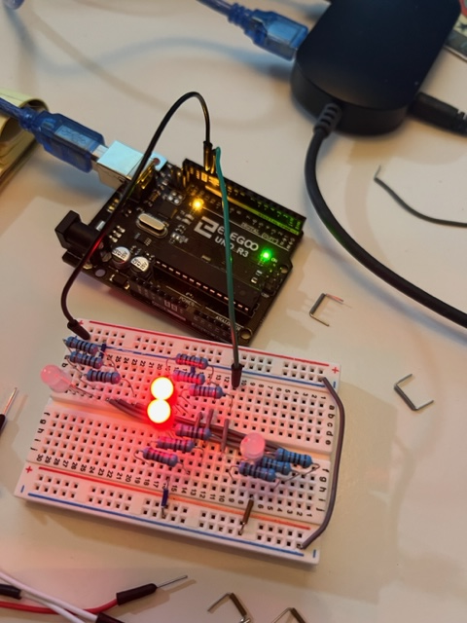
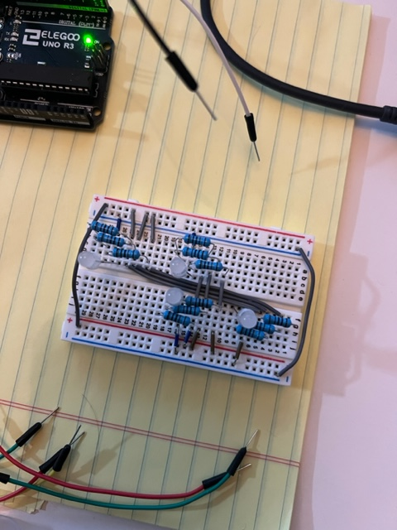
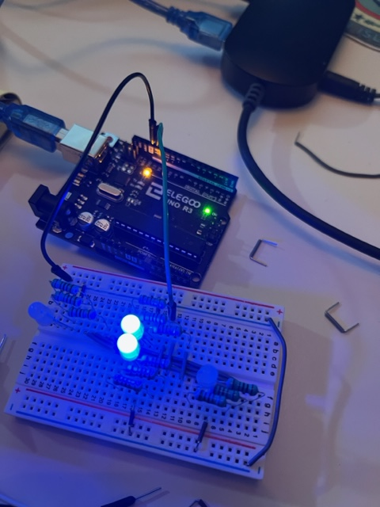
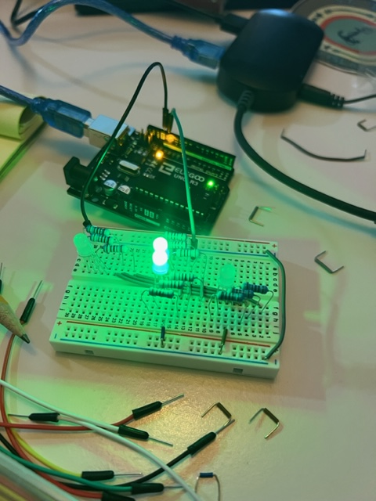
Working the lights
I got the lights to blink. This I had done in Tinkercad also to make sure I wasn’t going to blow up any lights and to make sure my connections were correct.
I made a video:
https://youtu.be/HgTewx9Js0k
Traffic Light 1

Slide 3
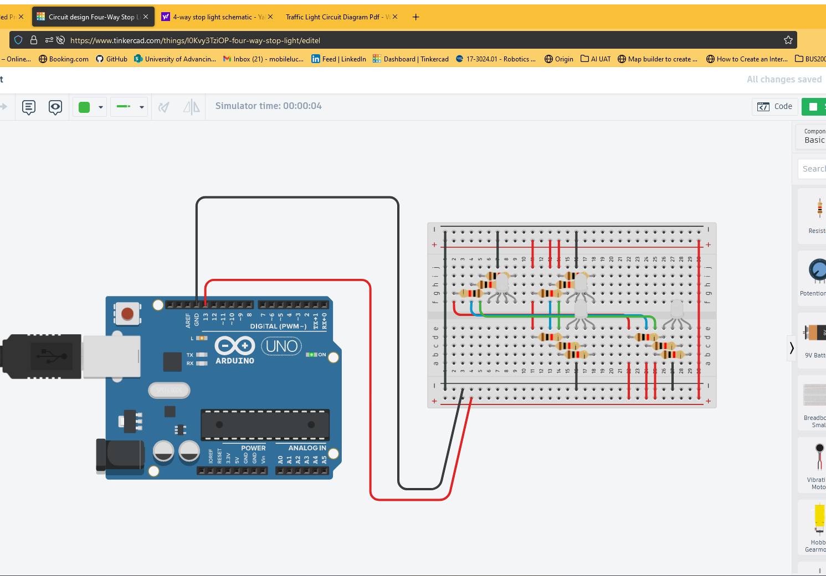
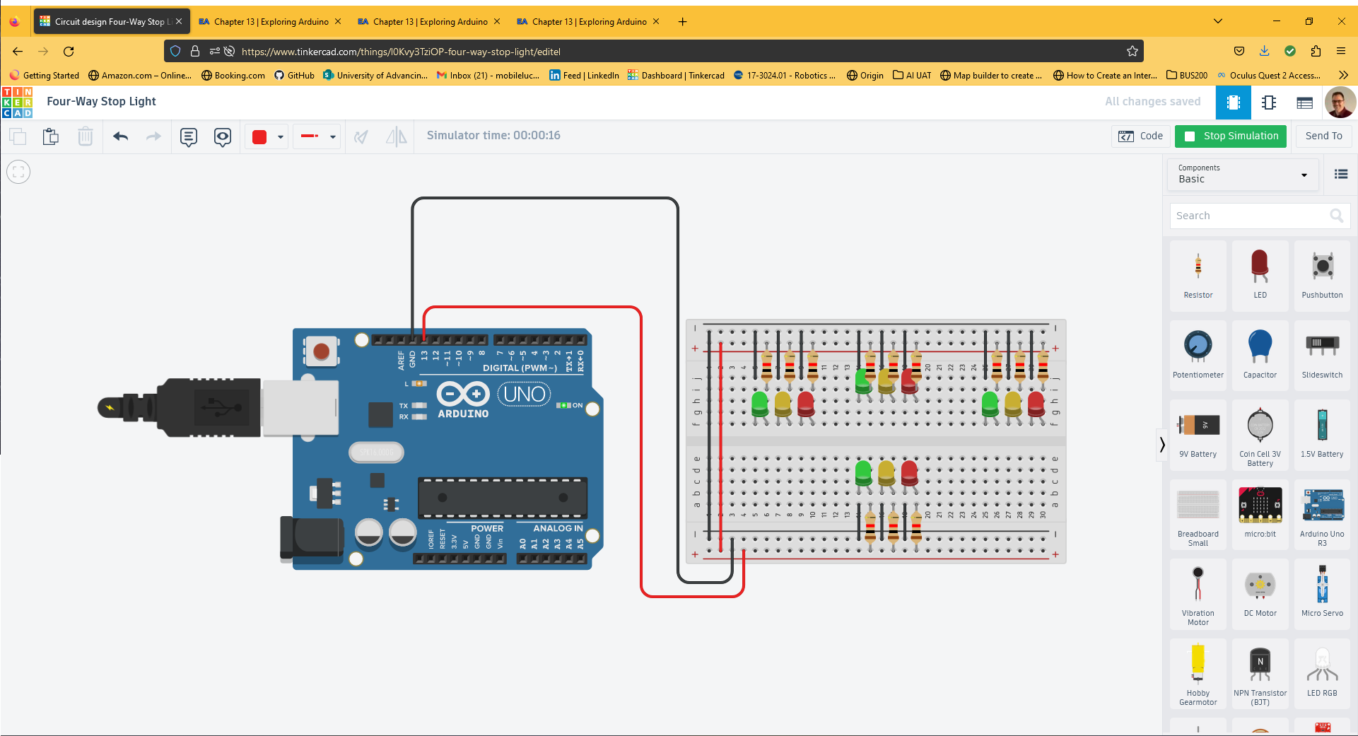
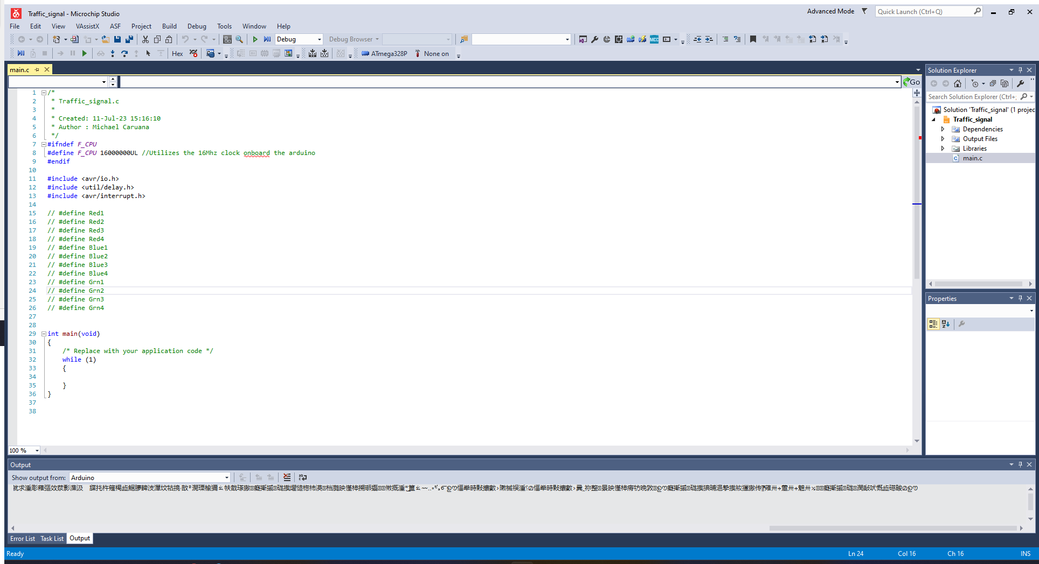
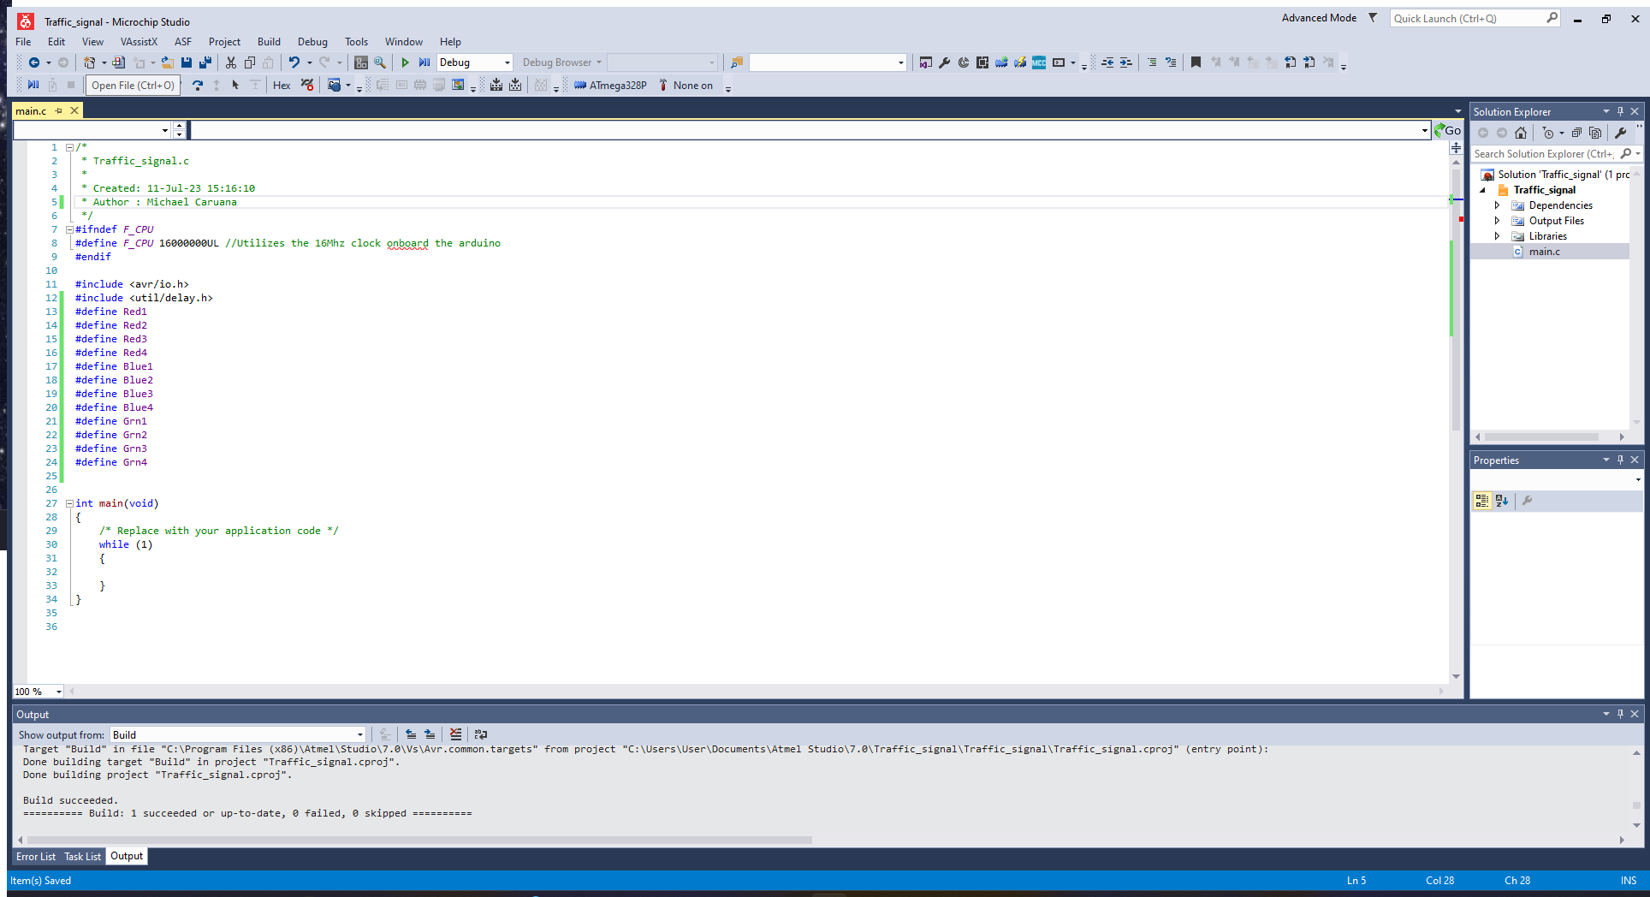
Tinkercad is helpful
I used Tinkercad to help build the circuit and got the RGB LEDs to blink together. This was just a phase in the grand scheme of things. Knowing the lights are connected correctly makes it easier to troubleshoot later.
I also defined some variables and ultimately removed some that were no longer needed. I eventually stopped using Tinkercad because I found a stable circuit to work with.

Slide 4
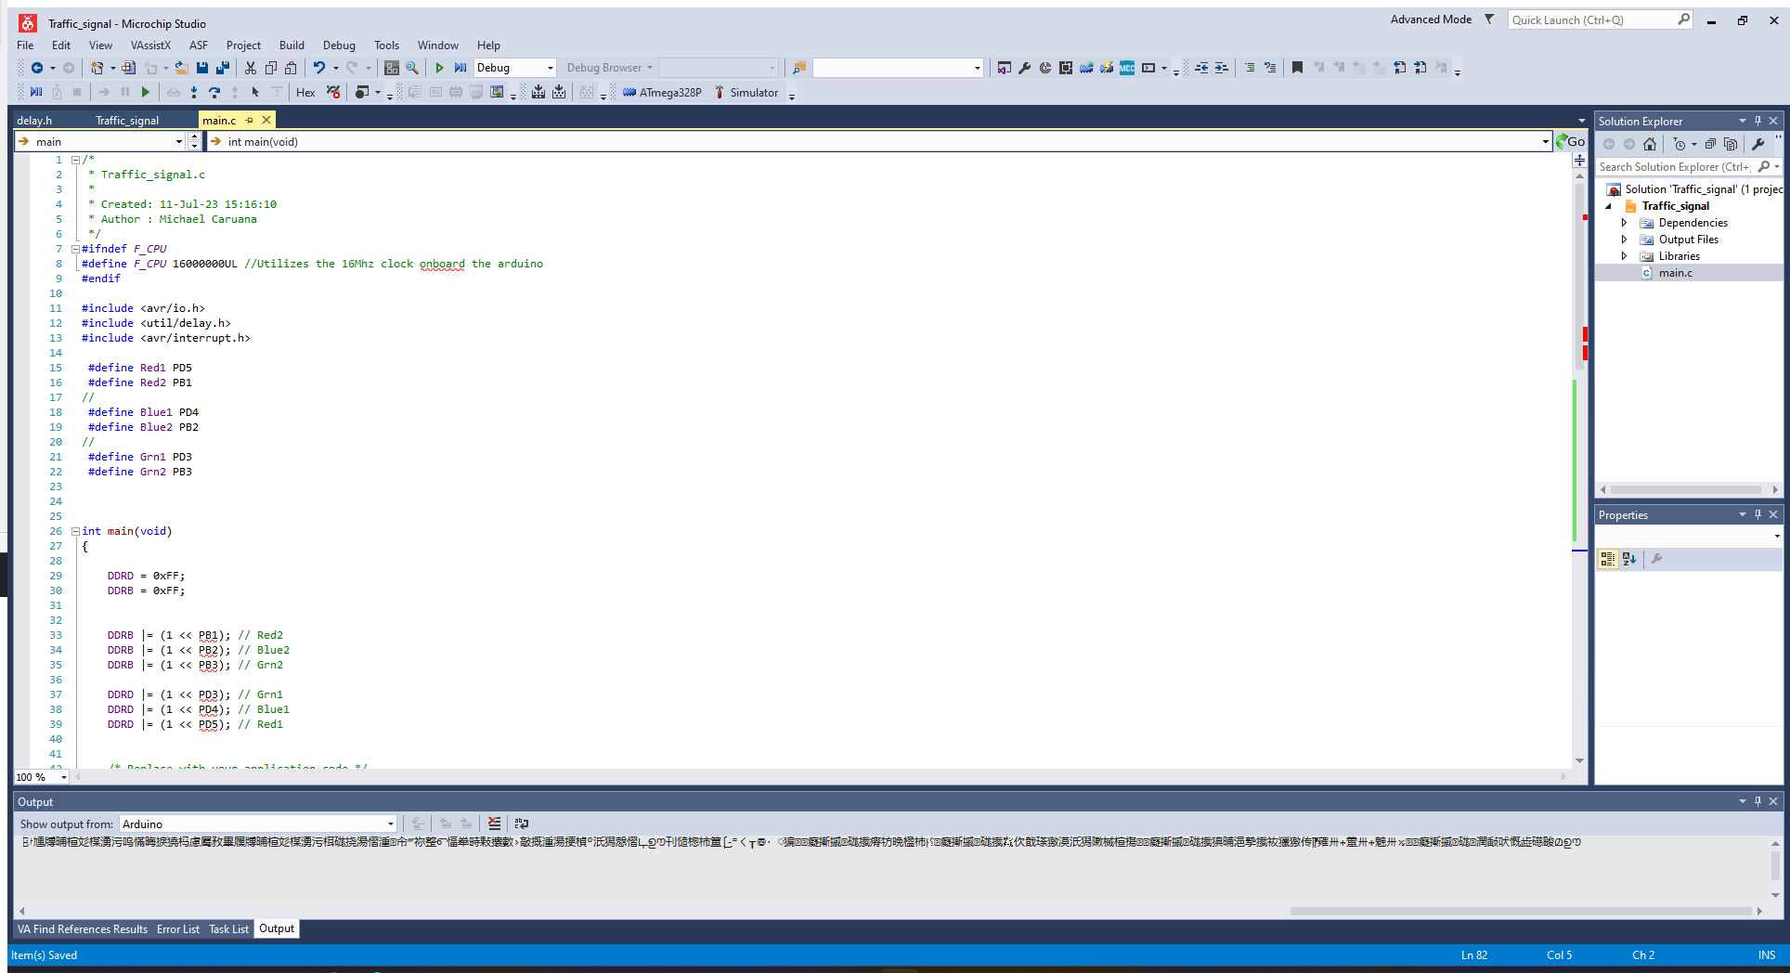
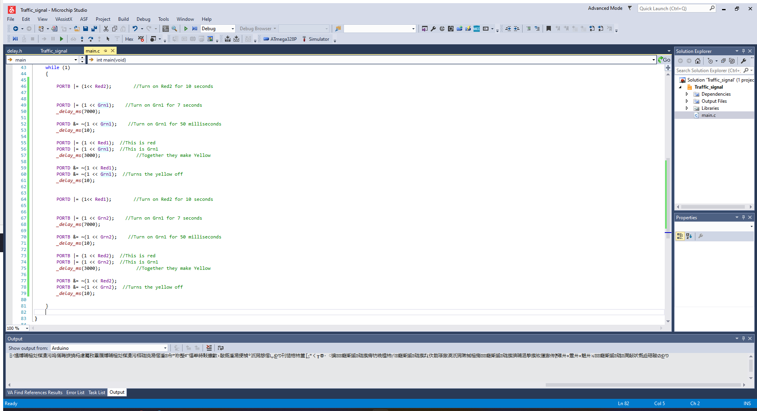
Beginning to work
I got the lights to work and I was going to use purple because I couldn’t figure out a yellow. I came across a yellow by accident in the program. After playing with the code for a bit I found the combination that made yellow and incorporated it into the program.
Here is a link to watch a short video:
https://youtu.be/w686ARQn_6M
Traffic Light video 2

Slide 5
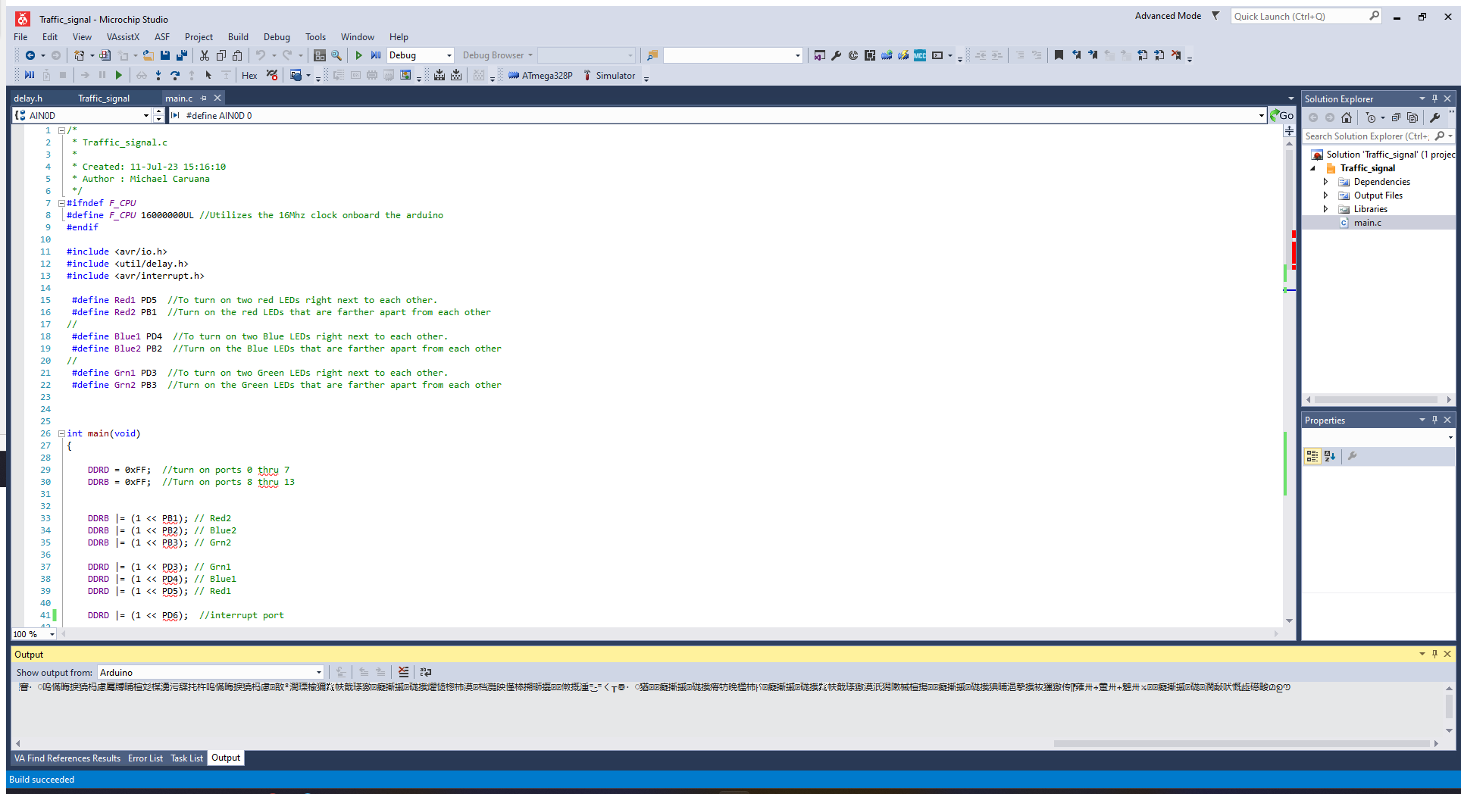
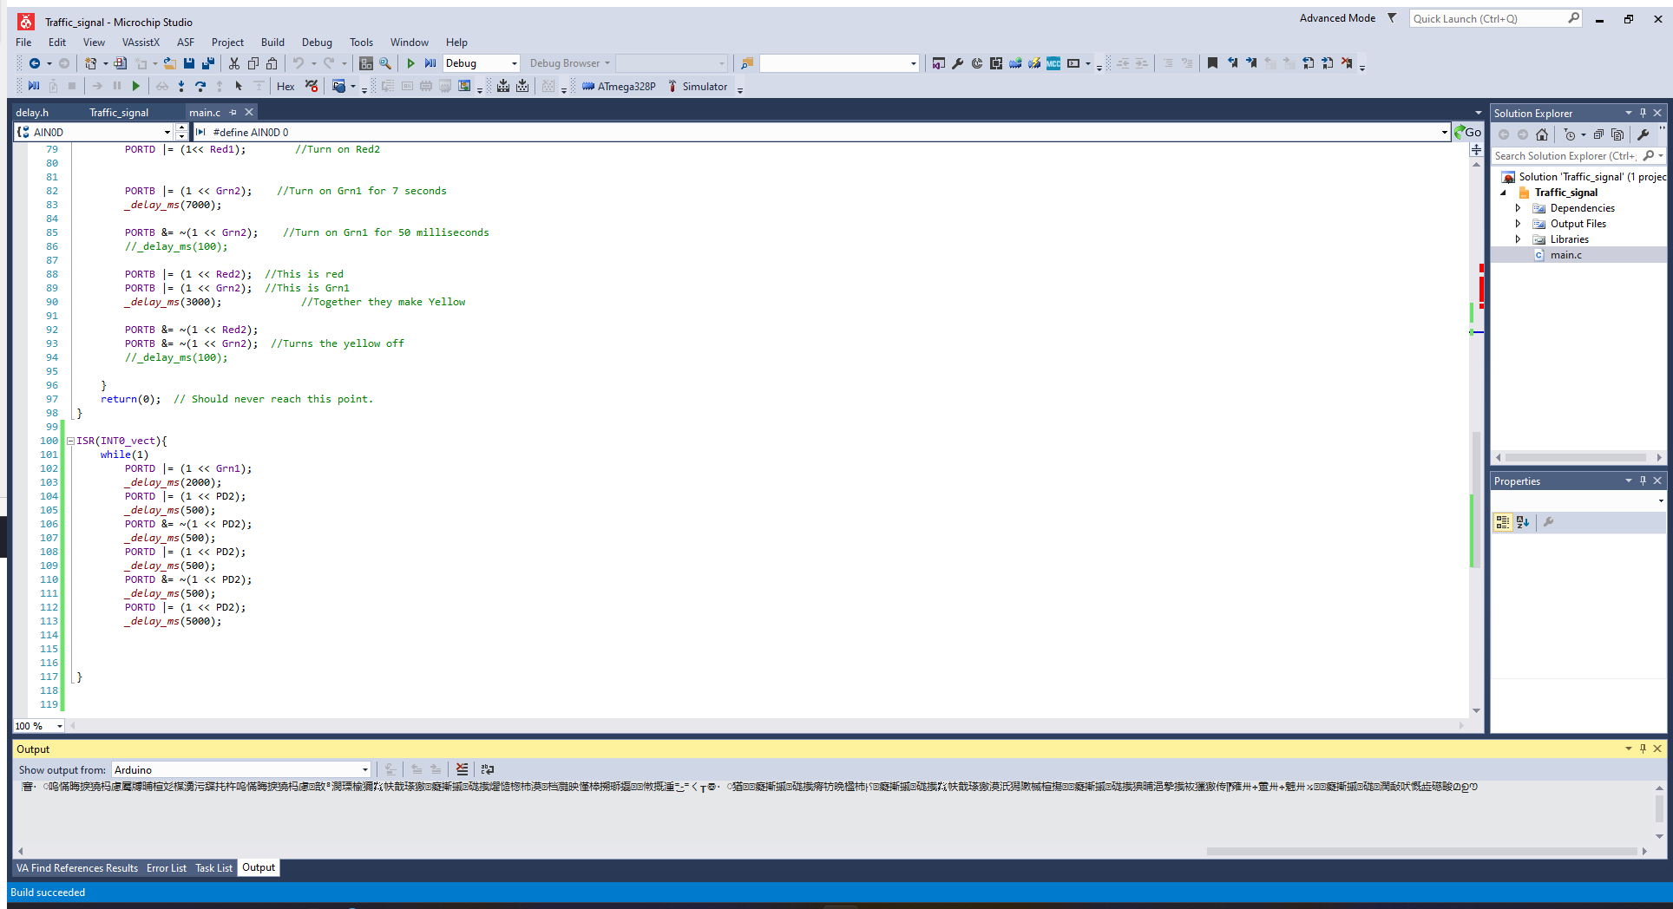
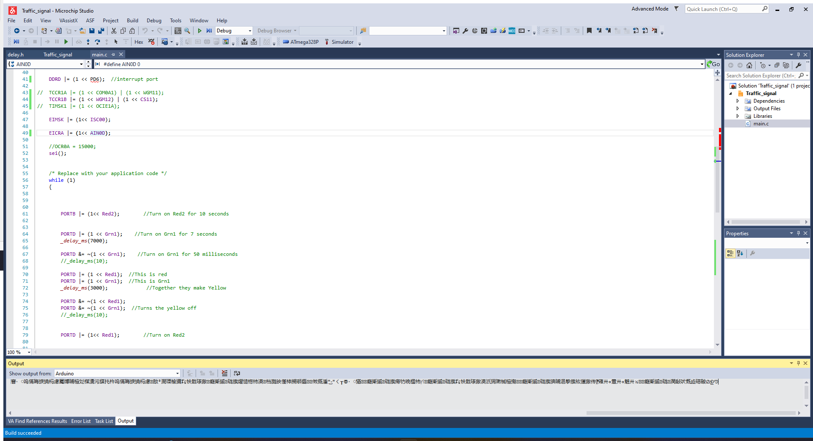
The Final Code
After trying to create an interrupt to have a light blink while one set of green lights is changing to red. The attempt was unsuccessful. I don’t understand interrupts as much as I think I did. I left the code in the final save in Microchip. Some of it I had to comment out because it made two of the lights not work.
I did try to go back and read about interrupts but it didn’t make anymore sense then when I first read it. I tried reading the datasheet and got nowhere also. I’m going to look into interrupts online later.

Slide 6
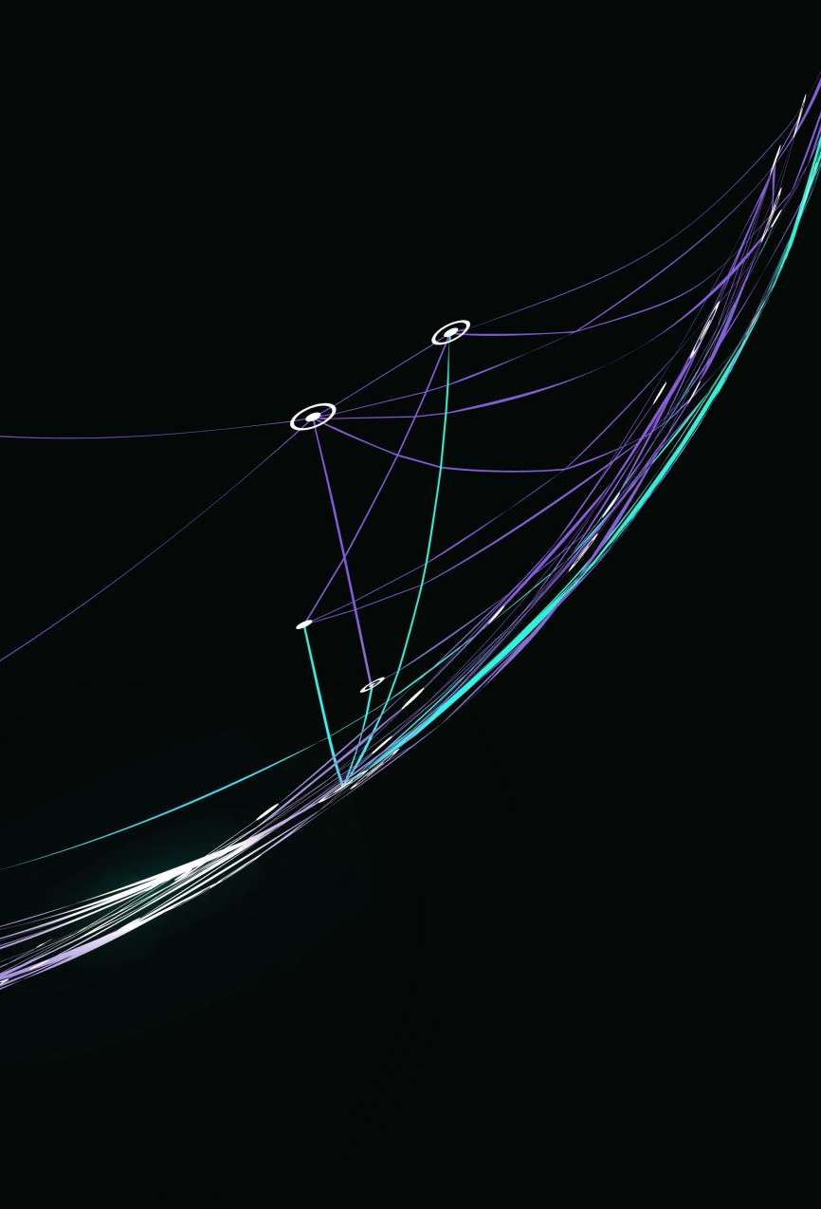
This is the End
I have a couple more videos to share for this project. I tried to document as much as possible. It is still a work in progress, but I have changed my habits to the better and I add other habits as I have been going through this school. I’m glad for this class because it showed me that I am weak at something, and I need improvement. That is what I am going to do. Here are the last videos I have for this project:
https://youtu.be/3H5l2JHik1c - This is video 3 not 4. I lost count and just didn’t start over.
https://youtu.be/9wHB4ki0dUw - This one is 4 not 5.
I hope you enjoy the videos, I did have fun making them.
Thank you
Michael Caruana

